Slide 1

ILP 2023 – W1S3 & W2S1 None type, Boolean type and functions
Matthieu DE MARI – Singapore University of Technology and Design

Slide 2
Outline (Week1, Session3 – W1S3)
The None type
The Boolean type
Boolean quiz
Advanced concepts on Booleans
Functions
Memory states in functions

Slide 3
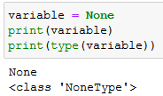
The None type
Definition (the None type): You can define a variable with an empty value, by assigning a None value to a variable. This is used to block a variable name in advance, even though no value has yet been assigned to it.

Slide 4
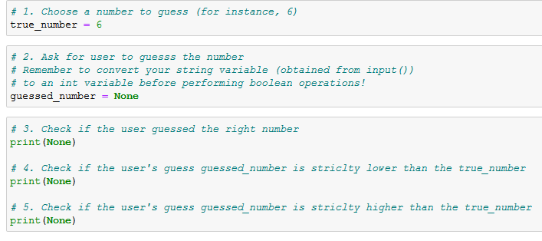
The None type
Definition (the None type): You can define a variable with an empty value, by assigning a None value to a variable. This is used to block a variable name in advance, even though no value has yet been assigned to it.
You will see me use it in some activities to “hint” on some variables or functions you should be using.

Slide 5
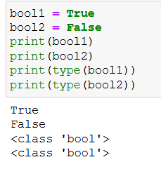
The boolean type
Definition (the boolean type): The boolean (bool) type is an essential type in programming. It is used to check if a condition is satisfied or not.
It can only take two values:
True, if the condition is satisfied;
or False, otherwise.

Slide 6
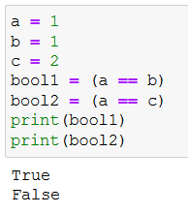
Boolean comparisons
Definition (the == operator): The == operator is used to check if two variables have identical values. The result of this operation is a Boolean, with value
True, if both variables have identical values;
and False, otherwise.

Slide 7
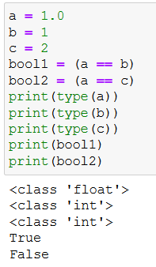
Boolean comparisons
Definition (the == operator): The == operator is used to check if two variables have identical values. The result of this operation is a Boolean, with value
True, if both variables have identical values;
and False, otherwise.
Note: Also, works if variables have mixed int/float types.

Slide 8
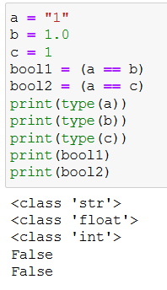
Boolean comparisons
Definition (the == operator): The == operator is used to check if two variables have identical values. The result of this operation is a Boolean, with value
True, if both variables have identical values;
and False, otherwise.
Note: Also, works if variables have mixed int/float types. But not with str and int/float!

Slide 9
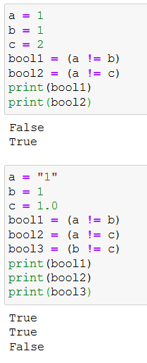
Boolean comparisons
Following the same logic as the == operator, we can define, the following operators, for numerical types (int/float).

Slide 10
Boolean comparisons
Following the same logic as the == operator, we can define, the following operators, for numerical types (int/float).
!=: if variables have different values.
Note: careful with the types on both sides! Let us only use these operators with similar types on both sides!

Slide 11
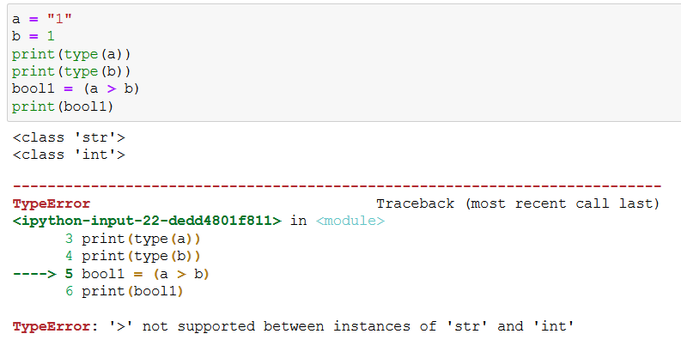
Boolean comparisons
Similarly,
>: if variable on the left-hand side has a higher numerical value, than the one on the right-hand side.
<: same as >, but checking for lower numerical value.
Note: careful with the types on both sides! Let us only use these operators with similar types!

Slide 12
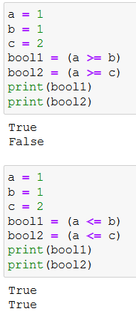
Boolean comparisons
Similarly,
>=: if variable on the left-hand side has a higher or equal numerical value, than the one on the right-hand side.
<=: same as >=, but checking for lower or equal numerical value.
Note: careful with the types on both sides! Let us only use these operators with similar types!

Slide 13
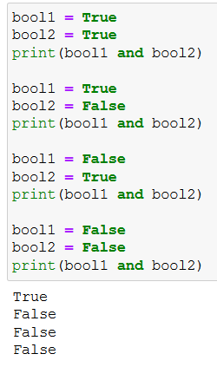
Boolean combinations: and, or, not
Definition (the and operator): The and operator returns a boolean with value True, if and only if both Boolean variables on the left- and right-hand sides of the and operator are True. It returns False otherwise.

Slide 14
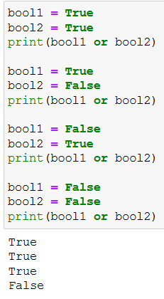
Boolean combinations: and, or, not
Similarly,
Definition (the or operator): The or operator returns a boolean with value True, if and only if at least one of the Boolean variables on the left- and right-hand sides of the or operator are True. It returns False otherwise.

Slide 15
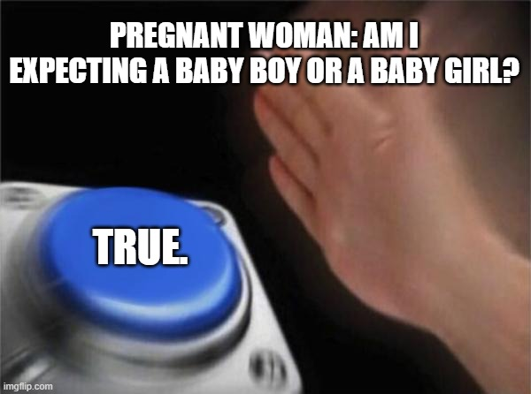

Boolean combinations: and, or, not
Similarly,
Definition (the or operator): The or operator returns a boolean with value True, if and only if at least one of the Boolean variables on the left- and right-hand sides of the or operator are True. It returns False otherwise.

Slide 16
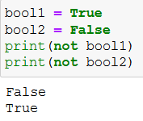
Boolean combinations: and, or, not
Definition (the not operator): The not operator returns a boolean with opposite value.
not True is False;
not False is True.

Slide 17
Boolean type: practice quiz!
Let us practice a bit with a quick quiz on Booleans!
https://forms.gle/irGU4MvVF174SaTk9

Slide 18
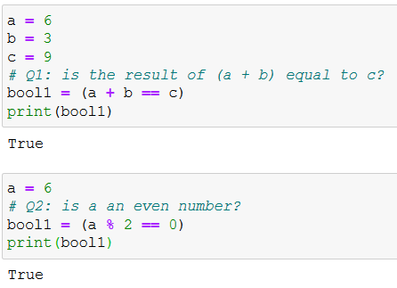
Boolean type: practice quiz! (answers)

Slide 19
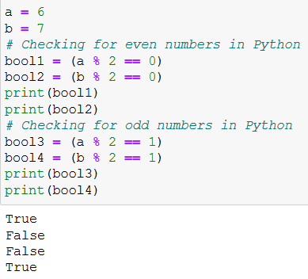
Boolean type: practice quiz! (answers)

Slide 20
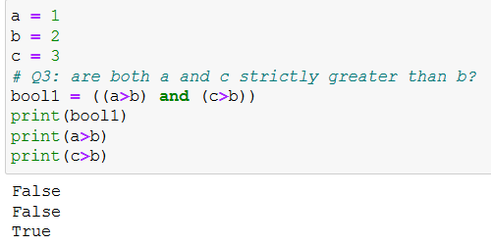
Boolean type: practice quiz! (answers)

Slide 21
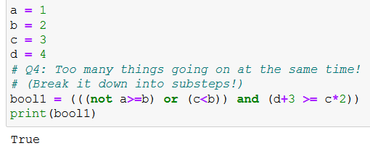
Boolean type: practice quiz! (answers)

Slide 22
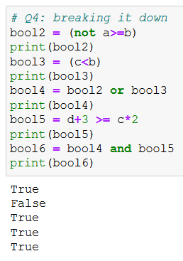
Boolean type: practice quiz! (answers)

Slide 23
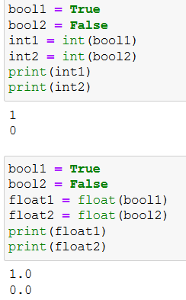
Boolean conversion
Bool -> Int/Float: You can convert a Boolean into an int/float number.
True transforms into 1 (int) or 1.0 (float).
False transforms into 0 (int) or 0.0 (float).

Slide 24
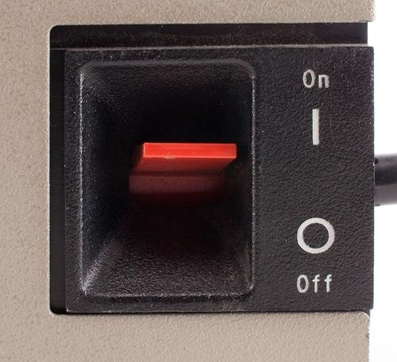
Boolean conversion
Bool -> Int/Float: You can convert a Boolean into an int/float number.
True transforms into 1 (int) or 1.0 (float).
False transforms into 0 (int) or 0.0 (float).
Fun fact: that is reason behind the on/off symbols.
On/True/1
Off/False/0

Slide 25
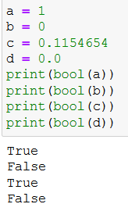
Boolean conversion
Int/Float -> Bool: You can convert an int/float number into a boolean.
Any non-zero numerical value becomes True.
A zero numerical value becomes False.

Slide 26
Activity 1: Guess the number game!
Let us play a bit with the concepts, with a first activity
You can find it in the notebook Activity 1 - Guess the number game.ipynb

Slide 27
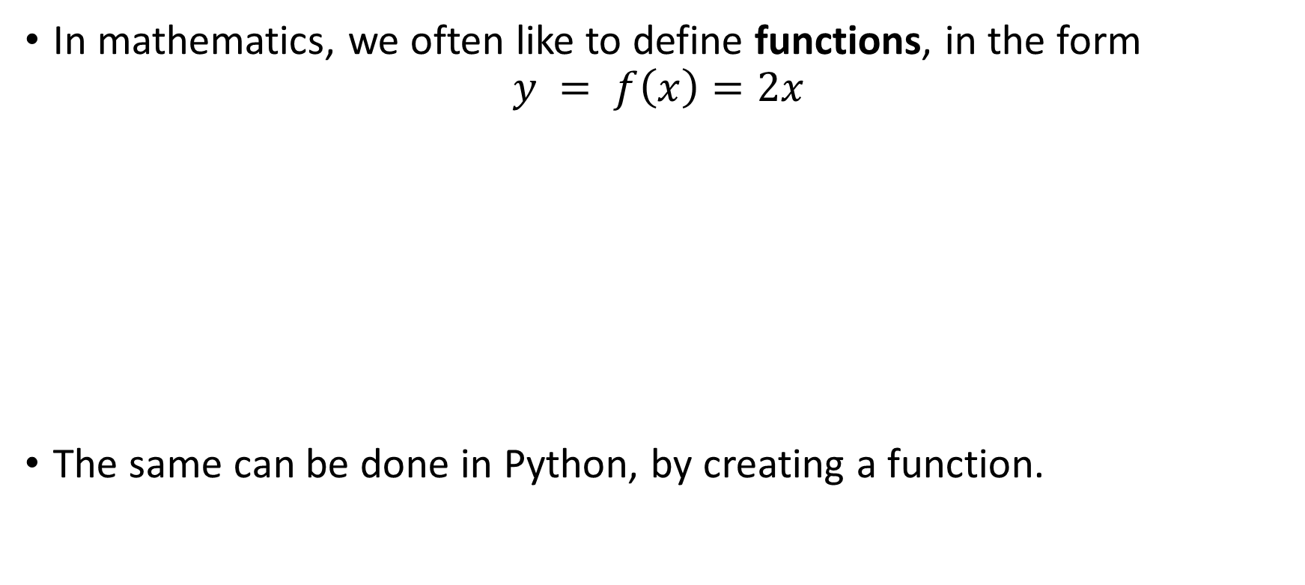
Function objects
In mathematics, we often like to define functions, in the form
$$y = f\left(x\right)=2x$$
The same can be done in Python, by creating a function.
Input $$x$$
Input 𝑥
Goes through function $f$
$$f(x) = 2x$$
Goes through function 𝑓
𝑓(𝑥) = 2𝑥
Output $$y=f\left(x\right)$$
Output 𝑦=𝑓(𝑥)

Slide 28
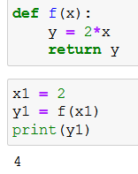
Function formatting in Python
Definition (Python functions): A Python function is a block of code which only runs when it is called. You can pass data, known as parameters or input values, into a function. A function can return data, as a result or output values.

Slide 29
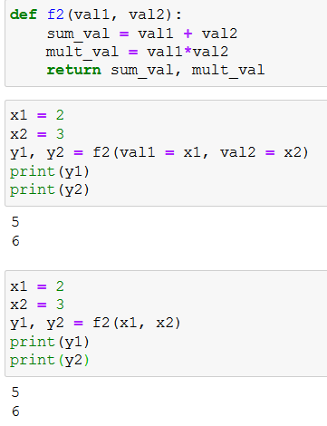
Function formatting in Python
You can define a function, with a def statement.
Immediately after def, type the function’s name.

Slide 30
Function formatting in Python
You can define a function, with a def statement.
Immediately after def, type the function’s name.
Between parentheses, after the function’s name, type input values/parameters.
You may have multiple inputs, separated with commas.

Slide 31
Function formatting in Python
Using the return keyword, type output values/results, that your function should give, if any.
You may have multiple outputs, as well as inputs, separated with commas.

Slide 32
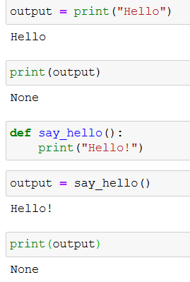
Function formatting in Python
Using the return keyword, type output values/results, that your function should give, if any.
You may have multiple outputs, as well as inputs, separated with commas.
Note: Your function may also not return anything (that is the case for the print() function!)

Slide 33
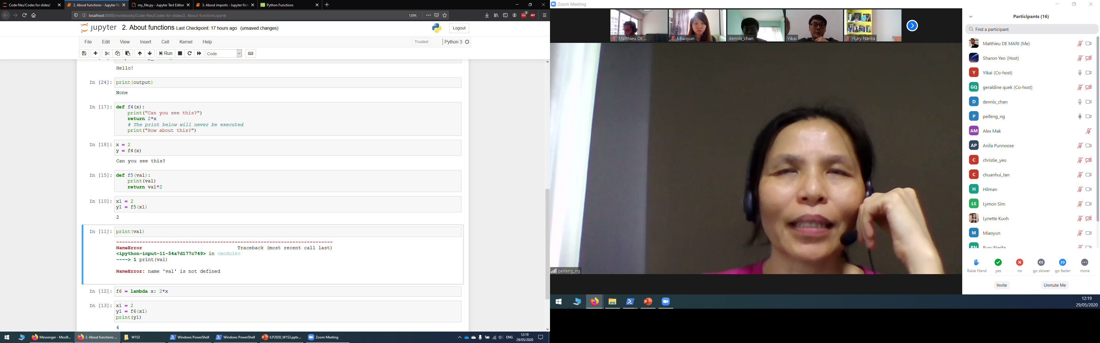
Function formatting in Python
In-between the def and return statement (if any), you may write lines of code to perform additional/intermediate tasks.
Important note: lines of code inside the function are indented with 4 spaces.

Slide 34
Function formatting in Python
In-between the def and return statement (if any), you may write lines of code to perform additional/intermediate tasks.
Important note: lines of code inside the function are indented with 4 spaces.
Important note: once a return is reached and executed, the function closes and will not execute anything else.

Slide 35
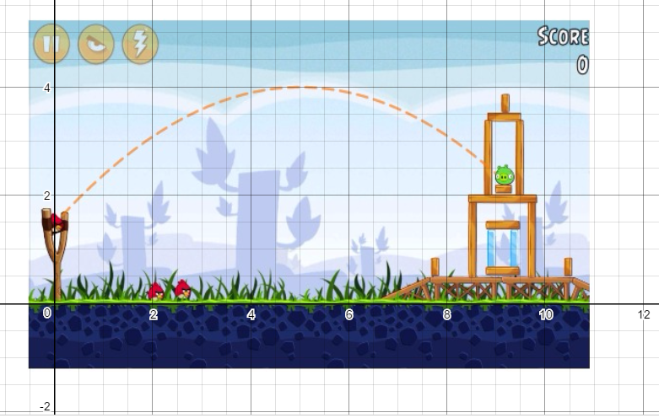
Activity 2: Ballistics of an angry bird
Let us practice these concepts with a second activity.
Check the notebook
Activity 2 - Ballistics of an angry bird.ipynb

Slide 36
Activity 2: Ballistics of an angry bird
Let us practice these concepts with a second activity.
Check the notebook
Activity 2 - Ballistics of an angry bird.ipynb
In this notebook, you will have to write a single function,
which computes the distance at which an angry bird will be landing,
depending on a given initial angle,
and an initial speed.

Slide 37
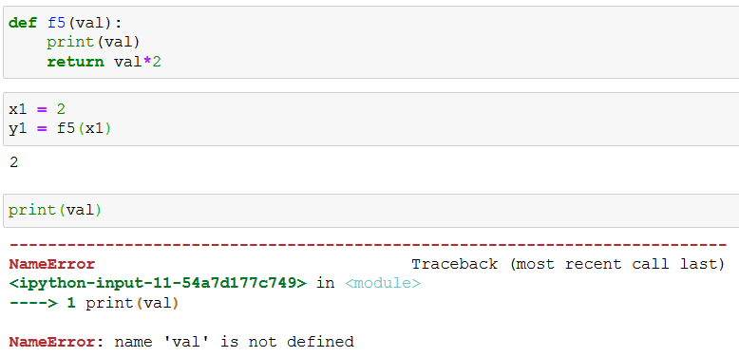
Variables in functions
Critical importance: variables defined inside the function are stored in memory while the function runs, but are cleared once the end of the function is reached. If you need to access a variable defined inside a function, it needs to be explicitly returned.

Slide 38
Variables in functions and memory state
Computer memory state
Python script
Global variables
my_function = Function of some sort defined on line 1.
x1 = integer variable with value 10
z1 = integer with value 23
Function variables (for instance on line 7)
x = integer variable with value 10
y = integer variable with value 20
z = integer variable with value 23
1 def my_function(x):
2 y = 2*x
3 z = y + 3
4 return z
5
6 x1 = 10
7 z1 = my_function(x1)
8 print(z1)

Slide 39
Variables in functions and memory state
Computer memory state
Python script
Global variables
my_function = Function of some sort defined on line 1.
x1 = integer variable with value 10
z1 = integer with value 23
Function variables (for instance on line 7)
x = integer variable with value 10
y = integer variable with value 20
z = integer variable with value 23
1 def my_function(x):
2 y = 2*x
3 z = y + 3
4 return z
5
6 x1 = 10
7 z1 = my_function(x1)
8 print(z1)

Slide 40
Variables in functions and memory state
Computer memory state
Python script
Global variables
my_function = Function of some sort defined on line 1.
x1 = integer variable with value 10
z1 = integer with value 23
Function variables (for instance on line 7)
x = integer variable with value 10
y = integer variable with value 20
z = integer variable with value 23
1 def my_function(x):
2 y = 2*x
3 z = y + 3
4 return z
5
6 x1 = 10
7 z1 = my_function(x1)
8 print(z1)
IGNORED FOR NOW

Slide 41
Variables in functions and memory state
Computer memory state
Python script
Global variables
my_function = Function of some sort defined on line 1.
x1 = integer variable with value 10
z1 = integer with value 23
Function variables (for function called on line 7)
x = integer variable with value 10
y = integer variable with value 20
z = integer variable with value 23
1 def my_function(x):
2 y = 2*x
3 z = y + 3
4 return z
5
6 x1 = 10
7 z1 = my_function(x1)
8 print(z1)

Slide 42
Variables in functions and memory state
Computer memory state
Python script
Global variables
my_function = Function of some sort defined on line 1.
x1 = integer variable with value 10
z1 = integer with value 23
Function variables (for function called on line 7)
x = integer variable with value 10
y = integer variable with value 20
z = integer variable with value 23
1 def my_function(x):
2 y = 2*x
3 z = y + 3
4 return z
5
6 x1 = 10
7 z1 = my_function(x1)
8 print(z1)

Slide 43
Variables in functions and memory state
Computer memory state
Python script
Global variables
my_function = Function of some sort defined on line 1.
x1 = integer variable with value 10
z1 = integer with value 23
Function variables (for function called on line 7)
x = integer variable with value 10
y = integer variable with value 20
z = integer variable with value 23
1 def my_function(x):
2 y = 2*x
3 z = y + 3
4 return z
5
6 x1 = 10
7 z1 = my_function(x1)
8 print(z1)

Slide 44
Variables in functions
Computer memory state
Python script
Global variables
my_function = Function of some sort defined on line 1.
x1 = integer variable with value 10
z1 = integer with value 23
Function variables (for function called on line 7)
x = integer variable with value 10
y = integer variable with value 20
z = integer variable with value 23
1 def my_function(x):
2 y = 2*x
3 z = y + 3
4 return z
5
6 x1 = 10
7 z1 = my_function(x1)
8 print(z1)

Slide 45
Variables in functions and memory state
Computer memory state
Python script
Global variables
my_function = Function of some sort defined on line 1.
x1 = integer variable with value 10
z1 = integer with value 23
Function variables (for function called on line 7)
x = integer variable with value 10
y = integer variable with value 20
z = integer variable with value 23
1 def my_function(x):
2 y = 2*x
3 z = y + 3
4 return z
5
6 x1 = 10
7 z1 = my_function(x1)
8 print(z1)

Slide 46
Variables in functions and memory state
Computer memory state
Python script
Global variables
my_function = Function of some sort defined on line 1.
x1 = integer variable with value 10
z1 = integer with value 23
Function variables (for function called on line 7)
x = integer variable with value 10
y = integer variable with value 20
z = integer variable with value 23
1 def my_function(x):
2 y = 2*x
3 z = y + 3
4 return z
5
6 x1 = 10
7 z1 = my_function(x1)
8 print(z1)
Before ending the function, Python will clear all the variables related to this function to save space.

Slide 47
Variables in functions and memory state
Computer memory state
Python script
Global variables
my_function = Function of some sort defined on line 1.
x1 = integer variable with value 10
z1 = integer with value 23
Function variables (for instance on line 7)
x = integer variable with value 10
y = integer variable with value 20
z = integer variable with value 23
1 def my_function(x):
2 y = 2*x
3 z = y + 3
4 return z
5
6 x1 = 10
7 z1 = my_function(x1)
8 print(z1)

Slide 48
Variables in functions and memory state
Computer memory state
Python script
Global variables
my_function = Function of some sort defined on line 1.
x1 = integer variable with value 10
z1 = integer with value 23
Function variables (for instance on line 7)
x = integer variable with value 10
y = integer variable with value 20
z = integer variable with value 23
1 def my_function(x):
2 y = 2*x
3 z = y + 3
4 return z
5
6 x1 = 10
7 z1 = my_function(x1)
8 print(z1)

Slide 49
Variables in functions and memory state
Computer memory state
Python script
Global variables
my_function = Function of some sort defined on line 1.
x1 = integer variable with value 10
z1 = integer with value 23
Function variables (for instance on line 7)
x = integer variable with value 10
y = integer variable with value 20
z = integer variable with value 23
1 def my_function(x):
2 y = 2*x
3 z = y + 3
4 return z
5
6 x1 = 10
7 z1 = my_function(x1)
8 print(z1)
9 print(y) # No longer exists! Error!

Slide 50

Variables in functions and memory state
In other words…
What happens in Vegas,
Stays in Vegas.

Slide 51
Variables in functions and memory state
In other words…
What happens in Vegas,
Stays in Vegas.
the function
the function
(unless it is explicitly returned)

Slide 52

Matt’s Great advice #5
Matt’s Great Advice #5: use functions to avoid repetitions of code
Find yourself copy-pasting blocks of code, and only changing a few values in this block of code?
Then, you probably need a function of some sort, which is called multiple times.
Functions makes your coding modular, easier, and your code will look a lot more professional.

Slide 53
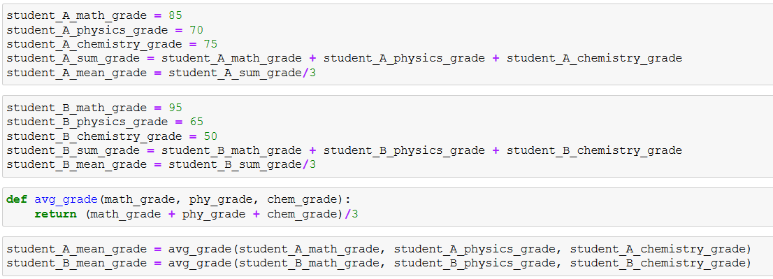
Matt’s Great advice #5: example

Slide 54
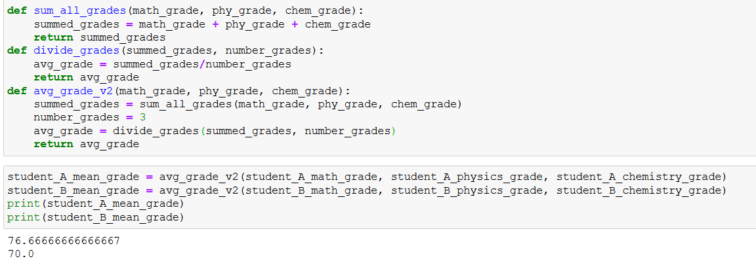
Subfunctions and calling them in other functions
You may find useful to define several functions and call them inside other functions. Again, this makes the code more modular, professional and readable.

Slide 55
Functional diagrams
If you have to design a function and/or several subfunctions, you might find it useful to draw a functional diagram.
See the one on the right, for the avg_grade() functions and its subfunctions.
A bit overkill right now, but….
When your code becomes heavier, breaking it down into well-chosen subfunctions, and keeping track of these functions will become essential.
Sum all grades received as inputs
Divide sum by number of grades
Return
avg_grade() function

Slide 56
Matt’s Great advice #6
Matt’s Great Advice #6: one main function to rule them all!
You may have defined several subfunctions and have designed a nice modular code.
Now is the time to define a main function that runs all of these functions at once. We often like to call it main().

Slide 57
Conclusion
The None type
The Boolean type
Boolean quiz
Advanced concepts on Booleans
Functions
Memory states in functions

Slide 58
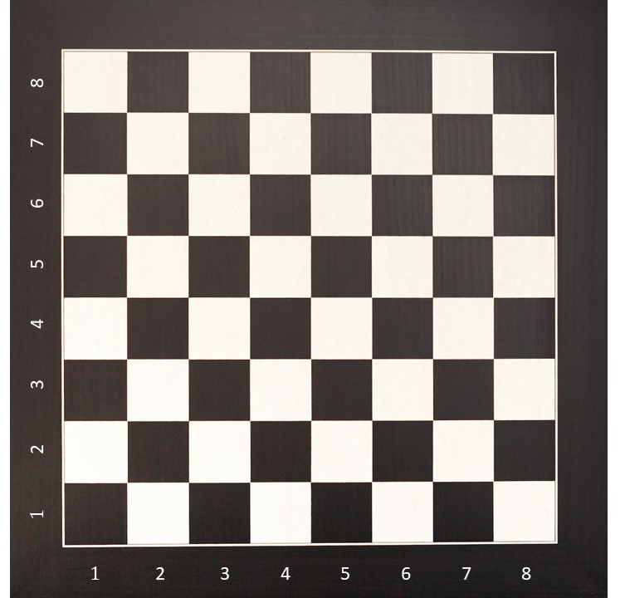
Activity 3: What color is the square?
Let us practice these concepts with more activities.
Check the notebook
Activity 3 - What color is the square.ipynb

Slide 59
Activity 3: What color is the square?
Let us practice these concepts with more activities.
Check the notebook
Activity 3 - What color is the square.ipynb
In this notebook, you will have to write several functions:
To collect user’s inputs on rows and columns indexes
To check and print if the square is black or white.
Later on, you should assemble them in a nice main() function!

Slide 60
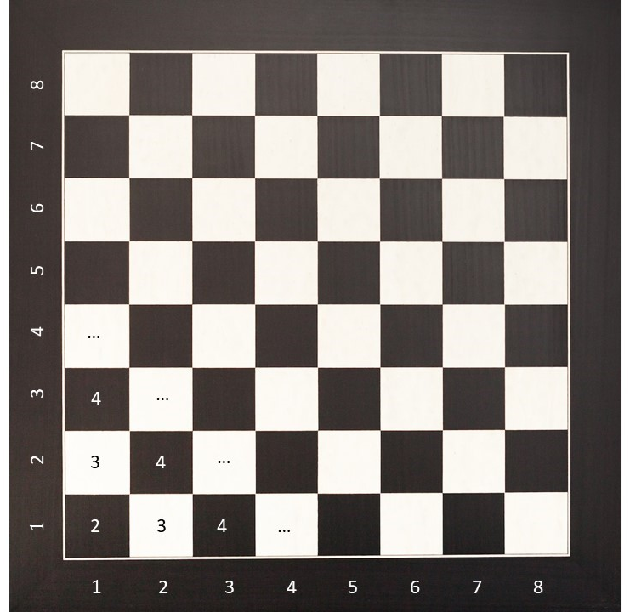
Activity 3: Hint
Hint: what do I get if I sum the row and column indexes for all squares?
Do you recognize a pattern?

Slide 61
More activities for you to practice!
Activity 4: Is this triangle rectangular?
Consider a triangle with three lengths values a, b, and c (with c being the largest of all three values).
Write a function, which receives all three values and returns a Boolean, with value:
True, if the triangle is rectangular.
False otherwise.
The function should return False, if the values a, b and c passed are such that c is not the largest of all three values.

Slide 62
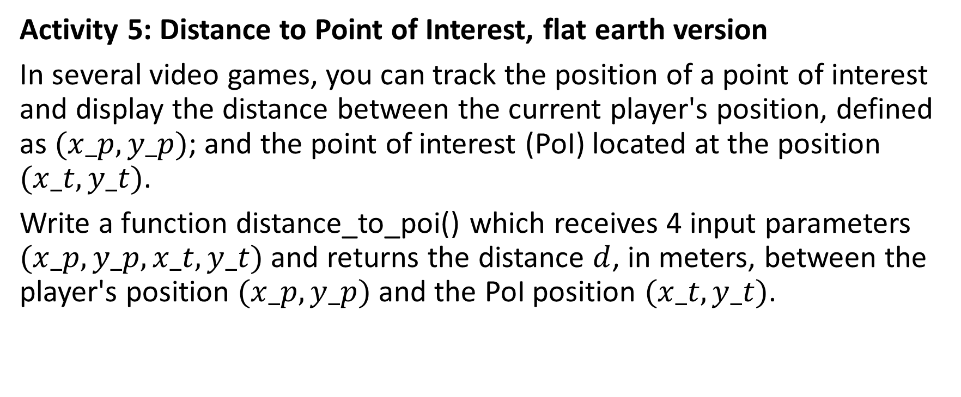
More activities for you to practice!
Activity 5: Distance to Point of Interest, flat earth version
In several video games, you can track the position of a point of interest and display the distance between the current player's position, defined as $(x_p, y_p)$; and the point of interest (PoI) located at the position $(x_t, y_t)$.
Write a function distance_to_poi() which receives 4 input parameters $(x_p, y_p, x_t, y_t)$and returns the distance $d$, in meters, between the player's position $(x_p, y_p)$and the PoI position $(x_t, y_t)$.

Slide 63
More activities for you to practice!
Activity 6: Distance to Point of Interest, spherical earth version
Same as Activity 5, but we now consider that the map model is no longer flat, but spherical.
Instead of (x,y) coordinates, we will use latitude and longitude coordinates.
The formula for computing the distance changes, into something slightly more difficult, which will require to import a few functions from the numpy library.

Slide 64
More activities for you to practice!
Activity 7: Guess the card game
Same as Activity 1 (guess the number), but we now consider that the player must guess a card (color and values) instead of just a number.
You will have to write a few subfunctions and a main() function.

